Slide 1
Computer System Overview
Lecture 5

Slide 2
Operating System
Exploits the hardware resources of one or more processors
Provides a set of services to system users
Manages secondary memory and I/O devices

Slide 3
Basic Elements
Processor
Main Memory
  referred to as real memory or primary memory
  volatile
I/O modules
  secondary memory devices
  communications equipment
  terminals
System bus
  communication among processors, memory, and I/O modules

Slide 4
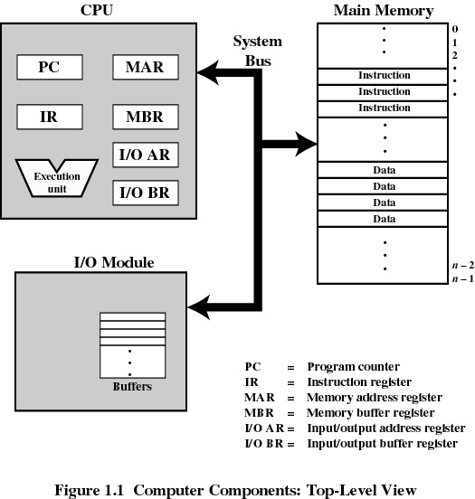
Top-Level Components

Slide 5
Processor Registers
User-visible registers
  Enable programmer to minimize main-memory references by optimizing register use
Control and status registers
  Used by processor to control operating of the processor
  Used by operating-system routines to control the execution of programs

Slide 6
User-Visible Registers
May be referenced by machine language
Available to all programs - application programs and system programs
Types of registers
  Data
  Address
    Index
    Segment pointer
    Stack pointer

Slide 7
User-Visible Registers
Address Registers
  Index
    involves adding an index to a base value to get an address
  Segment pointer
    when memory is divided into segments, memory is referenced by a segment and an offset
  Stack pointer
    points to top of stack

Slide 8
Control and Status Registers
Program Counter (PC)
  Contains the address of an instruction to be fetched
Instruction Register (IR)
  Contains the instruction most recently fetched
Program Status Word (PSW)
  condition codes
  Interrupt enable/disable
  Supervisor/user mode

Slide 9
Control and Status Registers
Condition Codes or Flags
  Bits set by the processor hardware as a result of operations
  Can be accessed by a program but not altered
  Examples
    positive result
    negative result
    zero
    Overflow

Slide 10
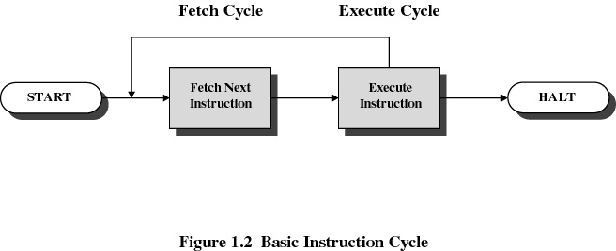
Instruction Cycle

Slide 11
Instruction Fetch and Execute
The processor fetches the instruction from memory
Program counter (PC) holds address of the instruction to be fetched next
Program counter is incremented after each fetch

Slide 12
Instruction Register
Fetched instruction is placed in the instruction register
Types of instructions
  Processor-memory
    transfer data between processor and memory
  Processor-I/O
    data transferred to or from a peripheral device
  Data processing
    arithmetic or logic operation on data
  Control
    alter sequence of execution

Slide 13
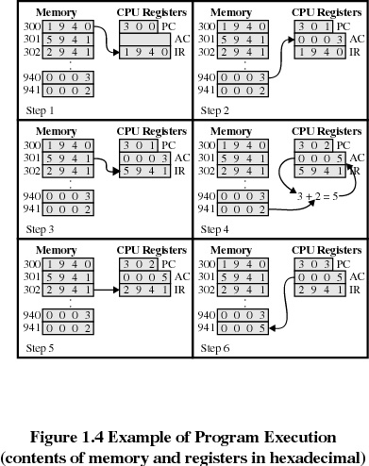
Example of Program Execution

Slide 14
INTERRUPT
An interrupt is a response by the processor to an event that needs attention from the software. An interrupt condition alerts the processor and serves as a request for the processor to interrupt the currently executing code when permitted, so that the event can be processed in a timely manner.

Slide 15
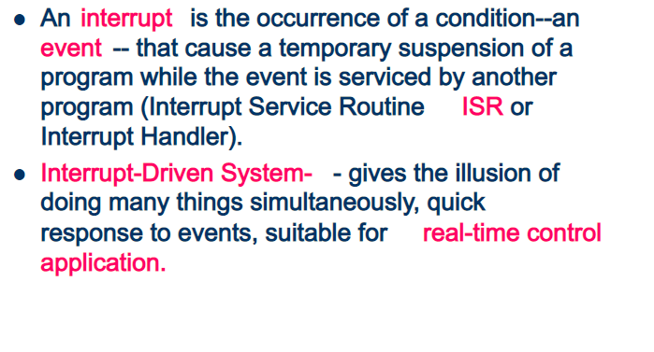
INTERRUPT

Slide 16
Conts….
An interrupt is a signal from a device attached to a computer or from a program within the computer that requires the OS to stop and figure out what to do next.
Almost all personal (or larger) computers today are interrupt-driven - that is, they start down the list of computer instructions in one program (perhaps an application such as a word processor) and keep running the instructions until either (A) they can't go any further or (B) an interrupt signal is sensed. After the interrupt signal is sensed, the computer either resumes running the current program or begins running another program.

Slide 17
Conts….
Basically, a single computer can perform only one computer instruction at a time. But, because it can be interrupted, it can take turns in which programs or sets of instructions that it performs. This is known as multitasking.
An operating system usually has some code that is called an interrupt handler. The interrupt handler prioritizes the interrupts and saves them in a queue if more than one is waiting to be handled. The operating system has another little program, sometimes called a scheduler, that figures out which program to give control to next.

Slide 18
Conts..
In general, there are hardware interrupts and software interrupts. A hardware interrupt occurs, for example, when an I/O operation is completed such as reading some data into the computer from a tape drive. A software interrupt occurs when an application program terminates or requests certain services from the operating system. In a personal computer, a hardware interrupt request (IRQ) has a value that associates it with a particular device.

Slide 19
Conts….
An interruption of the normal sequence of execution
Improves processing efficiency
Allows the processor to execute other instructions while an I/O operation is in progress
A suspension of a process caused by an event external to that process and performed in such a way that the process can be resumed

Slide 20
Classes of Interrupts
Program
  arithmetic overflow
  division by zero
  execute illegal instruction
  reference outside user’s memory space
Timer
I/O
Hardware failure

Slide 21
Interrupt Handler
A program that determines nature of the interrupt and performs whatever actions are needed
Control is transferred to this program
Generally part of the operating system

Slide 22
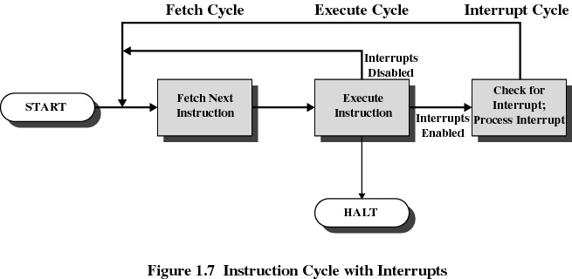
Interrupt Cycle

Slide 23
Interrupt Cycle
Processor checks for interrupts
If no interrupts fetch the next instruction for the current program
If an interrupt is pending, suspend execution of the current program, and execute the interrupt handler

Slide 24
Cont…..
Polling is an alternative approach
  Processor repeatedly requests the status of each device
  Increases in overhead as the complexity of the system increases
Polling is the process where the computer or controlling device waits for an external device to check for its readiness or state, often with low-level hardware

Slide 25
Interrupt Processing
Handling interrupts
  After receiving an interrupt, the processor completes execution of the current instruction, then pauses the current process
  The processor will then execute one of the kernel’s interrupt-handling functions
  The interrupt handler determines how the system should respond
  Interrupt handlers are stored in an array of pointers called the interrupt vector
  After the interrupt handler completes, the interrupted process is restored and executed or the next process is executed

Slide 26
Cont…..
An interrupt vector is the memory location of an interrupt handler, which prioritizes interrupts and saves them in a queue

Slide 27
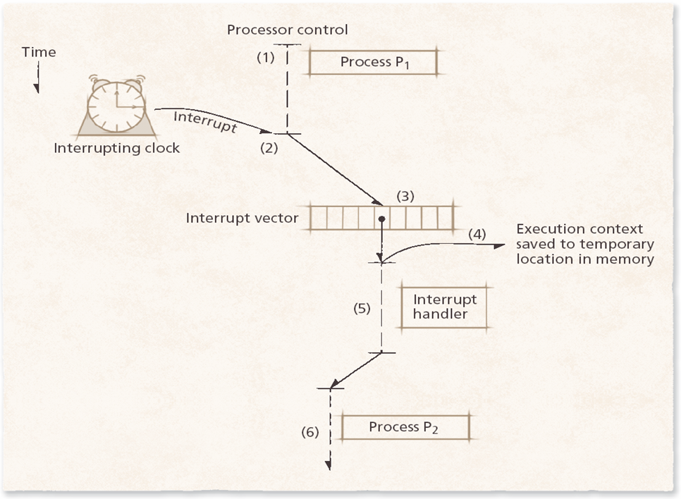
Handling Interrupt

Slide 28
Interrupt Classes
Supported interrupts depend on a system’s architecture
  The IA-32 specification distinguishes between two types of signals a processor may receive:
    Interrupts
      Notify the processor that an event has occurred or that an external device’s status has changed
      Generated by devices external to a processor
    Exceptions
      Indicate that an error has occurred, either in hardware or as a result of a software instruction
      Classified as faults, traps or aborts

Slide 29
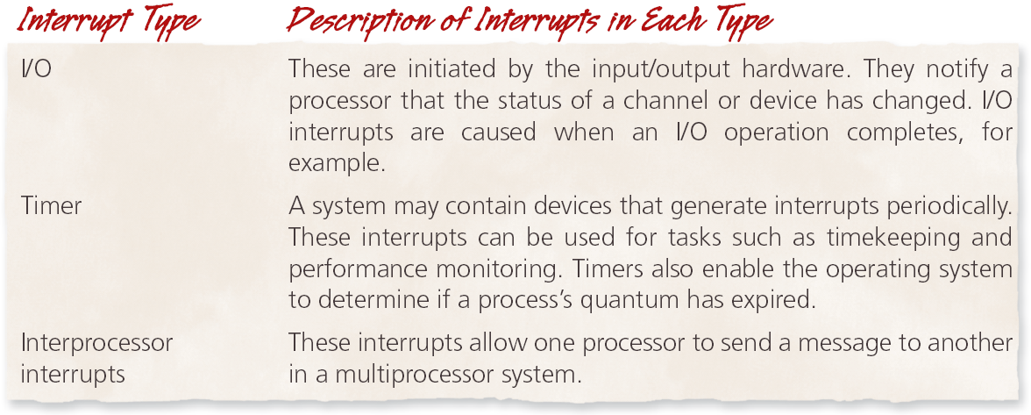
Common interrupt types recognized in the Intel IA-32 architecture

Slide 30
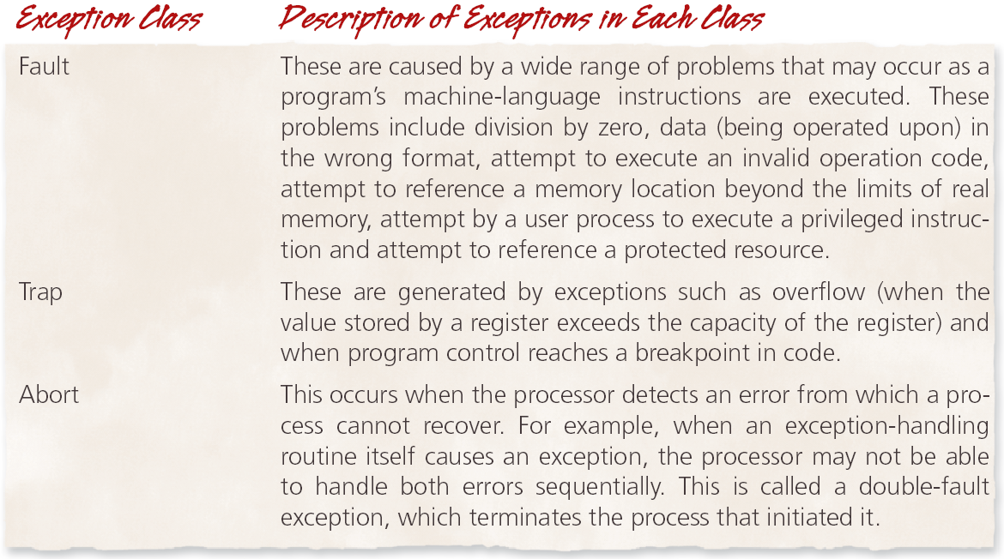
Intel IA-32 exception classes

Slide 31
Interprocess Communication
Many operating systems provide mechanisms for interprocess communication (IPC)
  Processes must communicate with one another in multiprogrammed and networked environments
    For example, a Web browser retrieving data from a distant server
  Essential for processes that must coordinate activities to achieve a common goal

Slide 32
Signals
Software interrupts that notify a process that an event has occurred
  Do not allow processes to specify data to exchange with other processes
  Processes may catch, ignore or mask a signal
    Catching a signal involves specifying a routine that the OS calls when it delivers the signal
    Ignoring a signal relies on the operating system’s default action to handle the signal
    Masking a signal instructs the OS to not deliver signals of that type until the process clears the signal mask

Slide 33
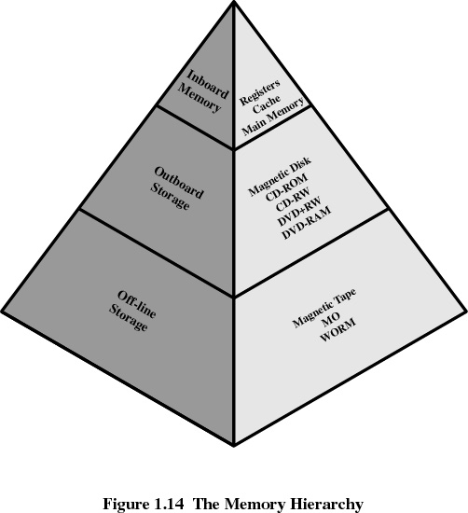
Memory Hierarchy

Slide 34
Going Down the Hierarchy
Decreasing cost per bit
Increasing capacity
Increasing access time
Decreasing frequency of access of the memory by the processor
  locality of reference

Slide 35
Disk Cache
A portion of main memory used as a buffer to temporarily to hold data for the disk
Disk writes are clustered
Some data written out may be referenced again. The data are retrieved rapidly from the software cache instead of slowly from disk

Slide 36
Cache Memory
Invisible to operating system
Increase the speed of memory
Processor speed is faster than memory speed

Slide 37
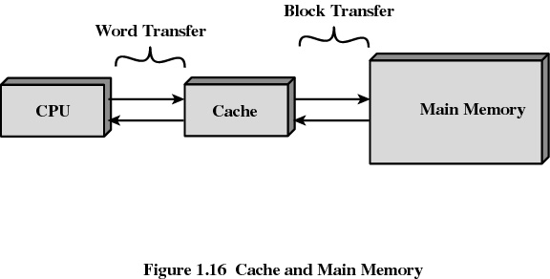
Cache Memory

Slide 38
Cache Memory
Contains a portion of main memory
Processor first checks cache
If not found in cache, the block of memory containing the needed information is moved to the cache

Slide 39
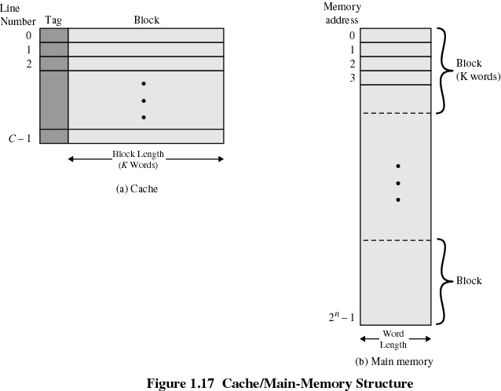
Cache/Main Memory System

